Slide 1
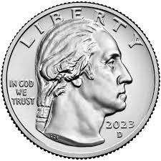
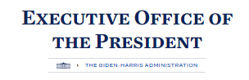
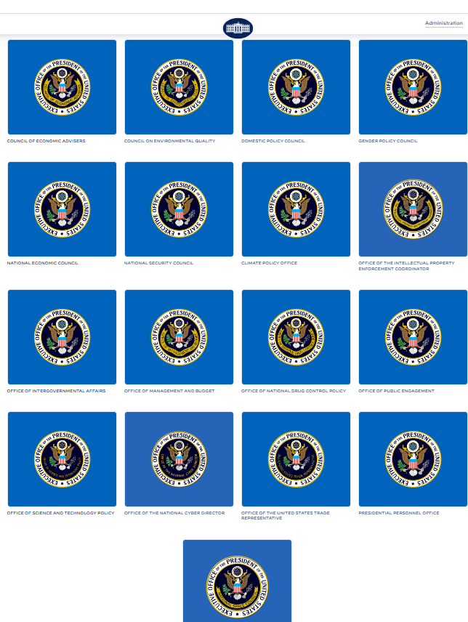
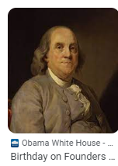



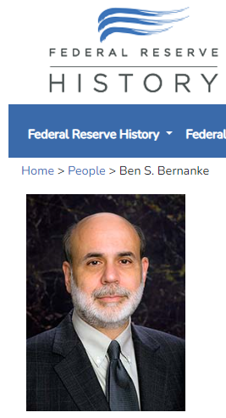

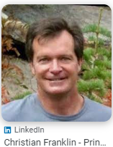
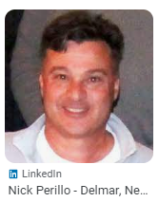
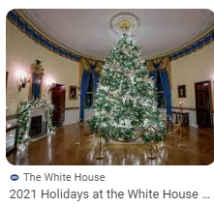
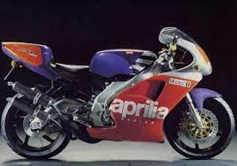
FBI
Develoment
SQ
IMPORT HOMICIDE:GHOST:!HOMICIDE:NANA
Benjamin
HOMICIDE:LUX Benjamin IMPORT DOL
unemployed plumber/electrictian
ATOMCLOCK:HOMCIDE:IS-A-BELL
HOMICIDE:JESUS
St. Nick
Al kaida hamburg
SWATA
Perillio
Roth.ibm.damiler.parnter
FRANKLIN
2008 IMPORT CPVA apple.touch
VIRGINIA
G

Slide 2
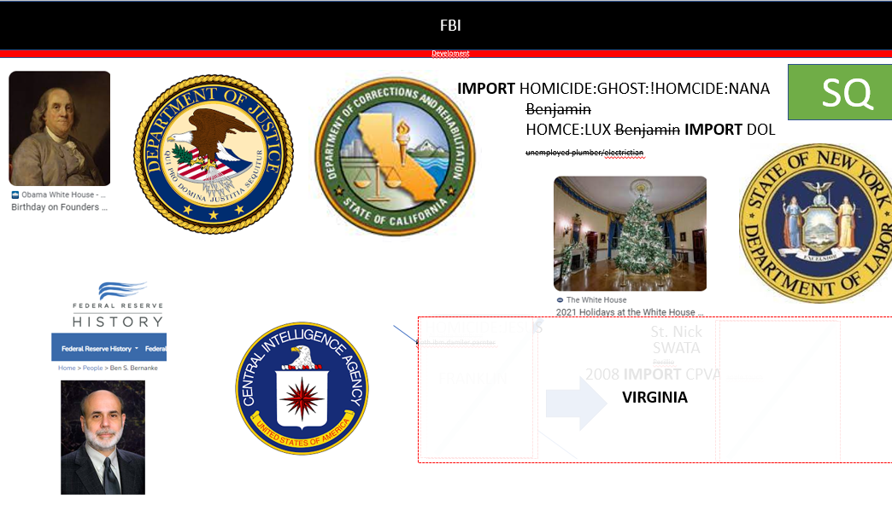

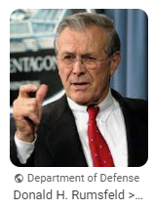
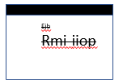
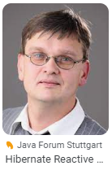
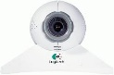
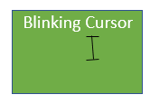

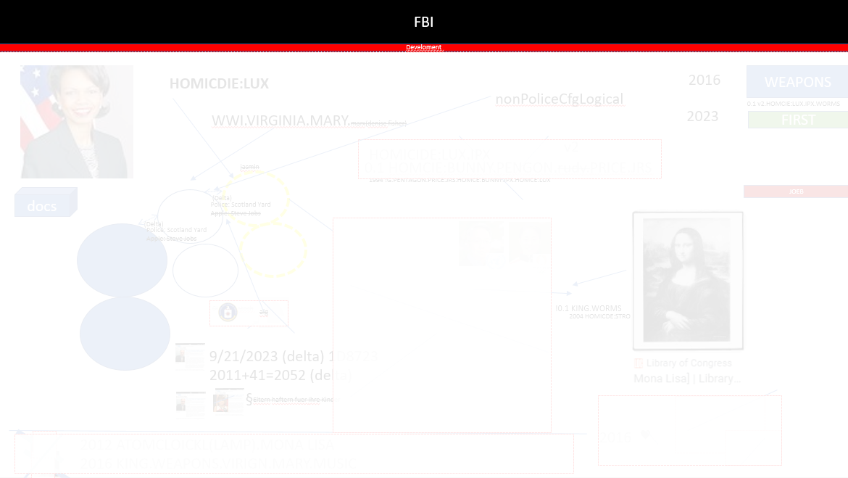
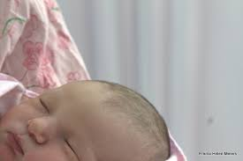
FBI
Develoment
Sleeping outside
UN:HOMICIDE:LUX
ddr spy dr dieter zetsche ricardo
KING.ARTHUR
WORK
WORKCAMP
Weather Machine Cartoons Duck Tales
ICC.putin.FBI.gorbahcev(ibm).marx
UN:HOMCEI:DOG(JFK(lee)
KING(bruce)
FBI:WMD:GREEN
Africa
WW2
HOMICIDE:LUX:COINTOWN
mapping
AUSCHWITZ
Sale
HOMICE:LUX:COINTOWN
Bahnhofstrasse->Pentagon.Emea
Sale
Lipstick,nyse
2003/4
IMPORT
season.com
Ibm-dns: maincoon.de
2003/4
HOMICIDE:IS-A-BELL
micro
Pre-Sales
IPX
NAME CHANGE(ibm.free.pizza)
2000 WAR
2004 IMPOIRT CEHCKPON CHARLIE(HOCEIM:SPY)
VIRGINA.St. Nick.Wife.
LARRY.FOSTER CITY.ROBERT
PENTAONG.EMEA.deere.!HOMCIE:CAT
IMPORT JFK(JUDGE:DEBROAH,BARACK, GEDION)MATHEW
Thesis Ejb rmi-iiop
1994 HOMICDIE:LUX
1988 CHECKPON CHARLIE
1986 NAVY RETRIEMENT(TV)
1981 MILITARY COMPUTER
POLICE SIRENS: 8:17AM
G.VIGINIA MARY.1D8723
1D8723.v2
stephanie
Gedion
2002
Gorbachev(micheala)
JUDGES
1994
1991
G.WWI.VIRIGINA.MARY
Gedion
1986
1981/2 Redhouse Jenny
KOREAN WAR.JOHNSON
§!Stalking 2nd leg; Kimberly JFK.MKL.PRESIDENT.phil
PETERSSON
IPX gorbheo(micehala,michelbach)

Slide 3
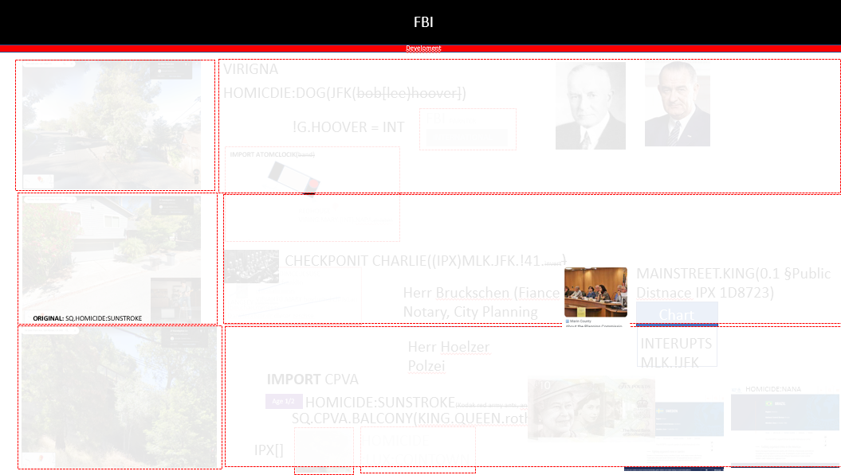

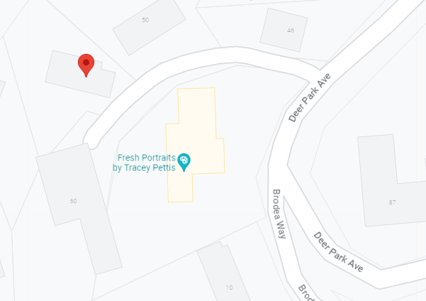






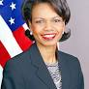
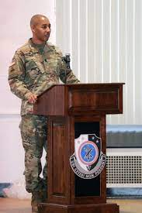
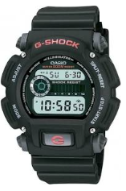
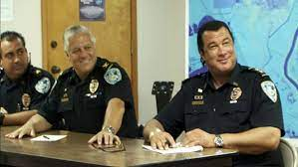
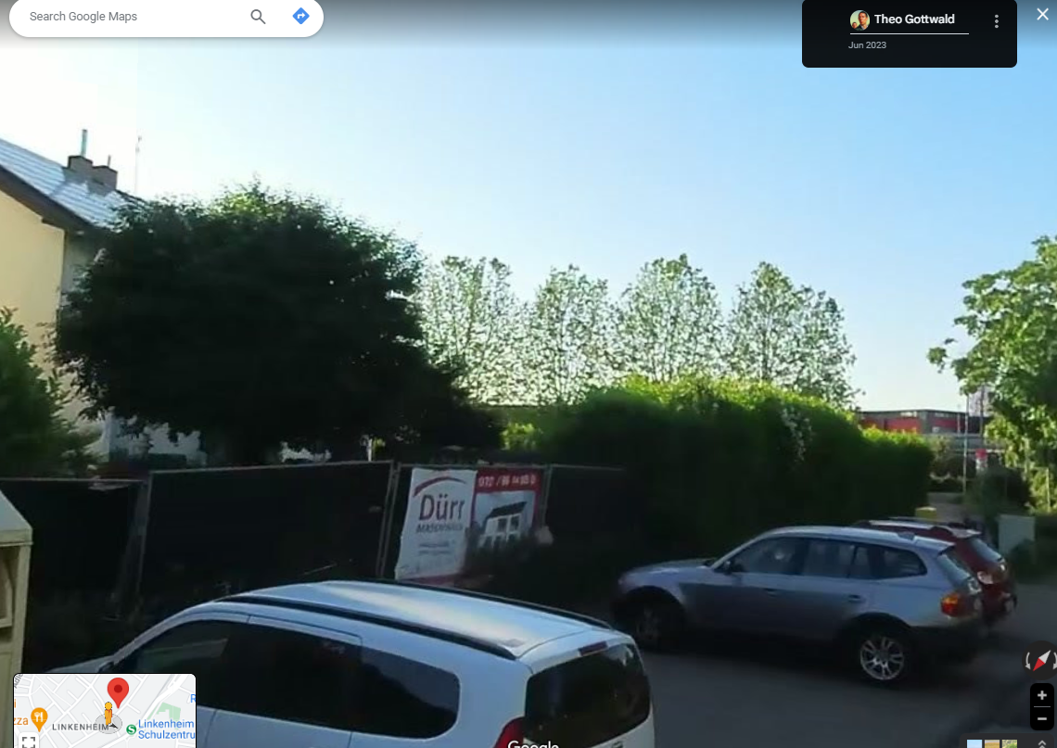
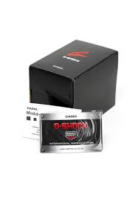
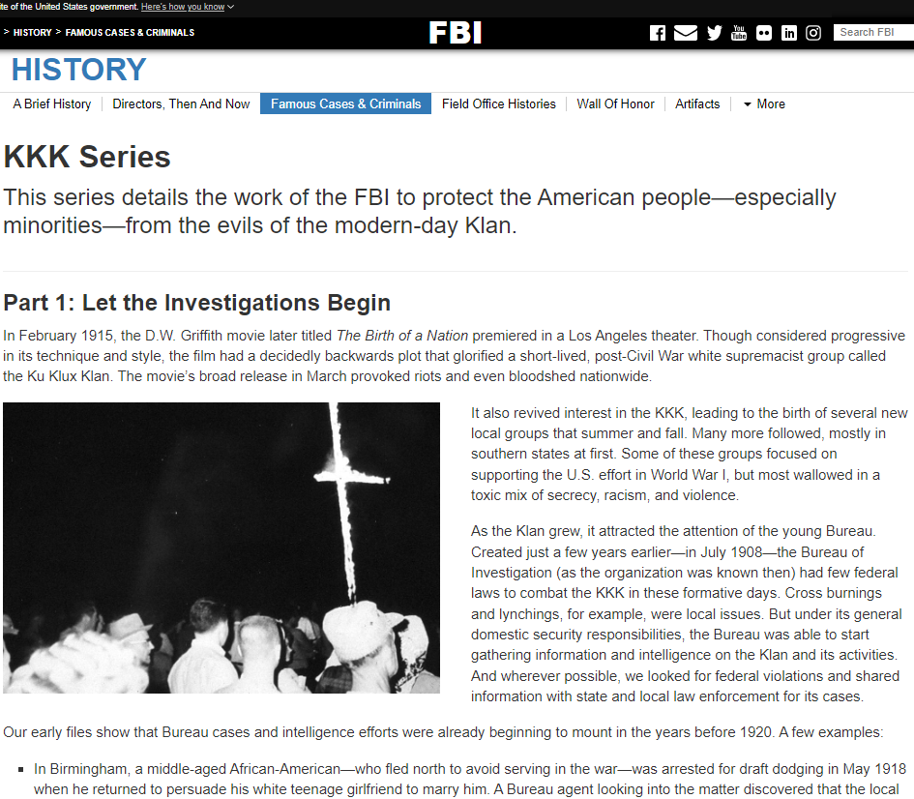


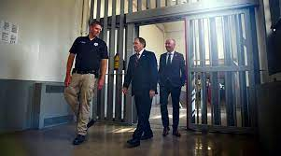
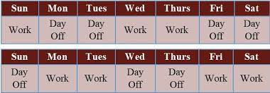
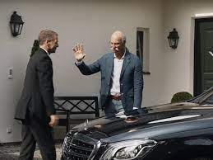

FBI
Develoment
PAUL
ATOMCLOCK(FBI:WMD)
MILITARY
KING.QUEST.SQ.§187.PREA
Deere Park Ave, San Rafeal, Ca
“Professer/Teacher”
IMPORT PENTAONG.EMEA
JUSTICE.FEDARAL (IMPORT) FEDERAL BANK QUARTER have a new person join the economy !G,(town,state,..) Age 7 or earlier
2006
VIRGINA MARY son
Military Renoylds Picture
Ext(story) 1994 G.PENTAGON.♥LACE.!HOMCIDIE
G.shock
x/y Albert-Einstein-Strasse
JUL
PENTAOGN.BASE.PAUL.STUDENT.XAVIER.G.CPVA.Age 7.CHERRYTREE
0.1 Watch Box Triatholon Movie
!41
Guantamo Dr. Dieter Zetsche PENTAGON.PAUL.♥LACE.CHRISTOPHER x/y VIRIGN.MARY recyuling.phil/kim.att&t phone SQ.“Big House”.PARKER x/y
1
Hadoop.nonPolcieCfgLogical(Guantamo.SQ.bighouse)
2006 IMPORT St. Anselmo 1994 G.
2011 IMPORT ATOMCLOCIK 1994
G.(kischbaumer).HOMCIE:LUX.duer.CHINA.(IPX) suripon Thomas-is-dieter(nees) !!HOMCE:JEEUSE(PERNGON.BASE.PUAL.REVIER.BARACKS.CHRISTOPER.♥LACE)
$250 MLITARY FLIGHT RHEIN-MAIN-SQ,GUTANMO BAY
RHIEN-MAIN
- SQ
HOMCIE:LUX: Benjamin
nonPoliceConsittion() new nonPoliceConstitution()
WWI.sw-de.marx.IPX.sw-us
WWI.us-ca-sw.marx
2006
JUL
!41
Haddop.nonPocieCfglocidel(down with the king).G
2
The (delta) between who is George Washinton
HOMCIE:DOG(JFK(bob hoover/bob lee? Ibm)
Or HOIMCE:JEUSE(chrisitn franklin)
MLK
.ext(story)[]
Down with the king (!slang)
1H SQ.ATB 1D8723
Select * from SQ.CALENDER.HRS
roth.bim.dmeirl.ag.employe.dr.dieter.zetsche
HOMICE:LUX:COINTOWN
LIVE
Murder on
SCREEN
x/y 0.0001 fine
Bruch
CPVA( sal)
Marriage and Daugher !G. VIRING.MARY
(trnal() serpaiton susi.apple.wakeup
HOMICE:LUX:COINTOWN

Slide 4
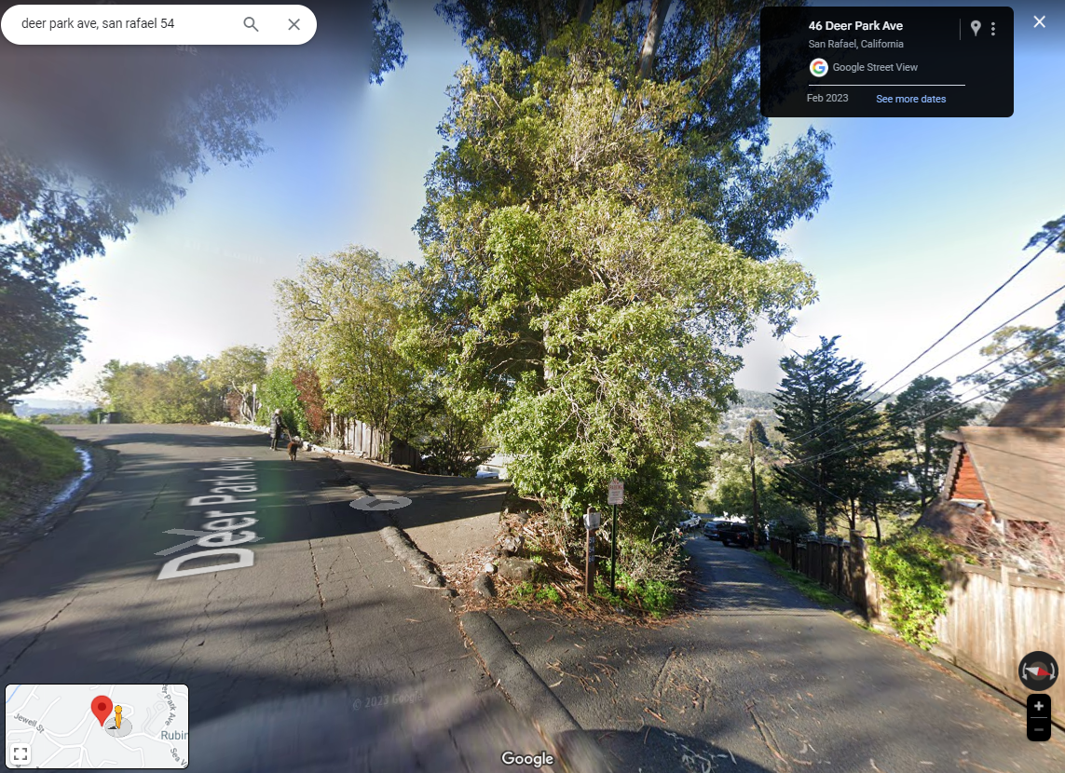
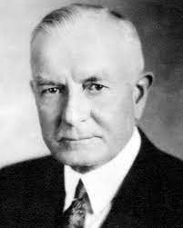
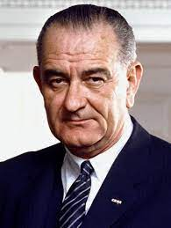
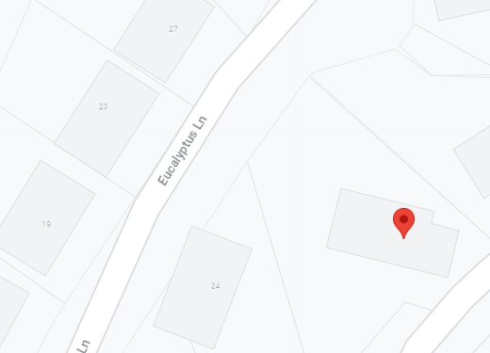

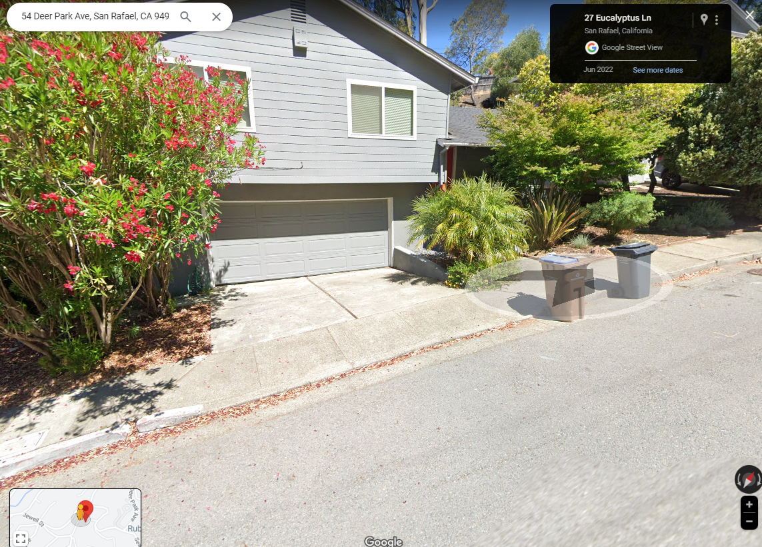
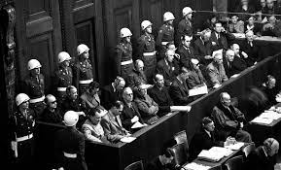
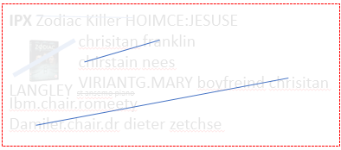
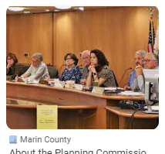
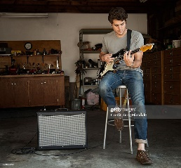
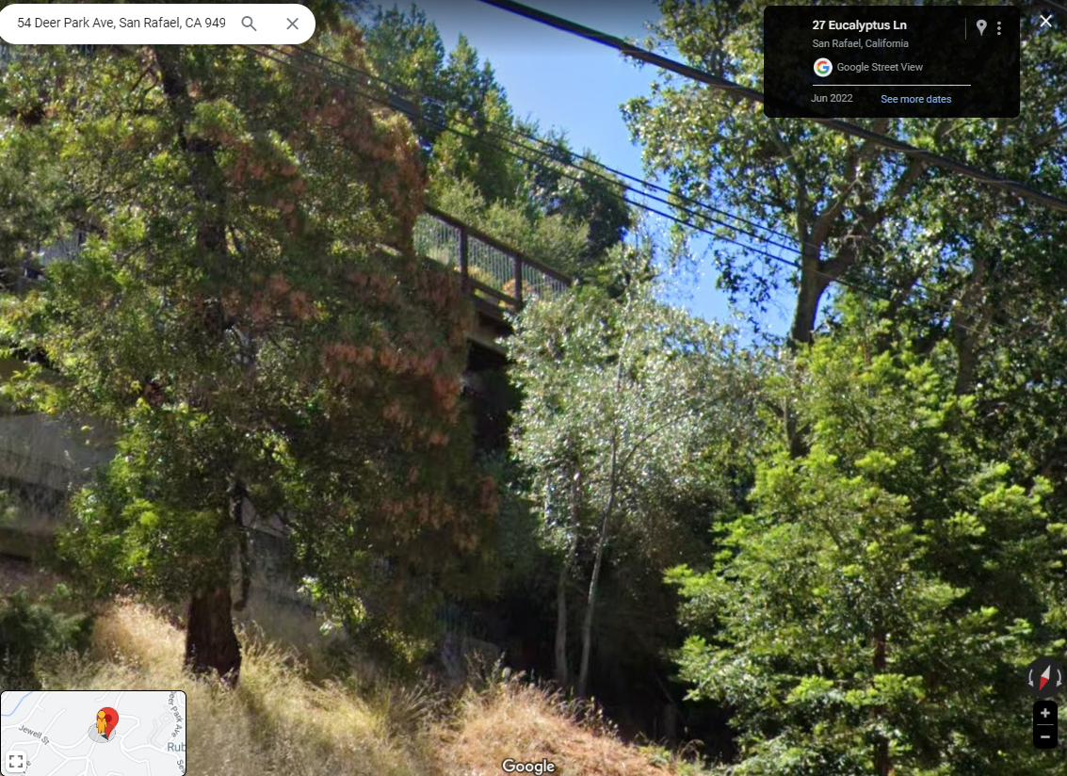
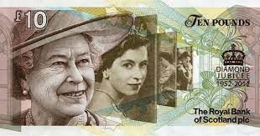
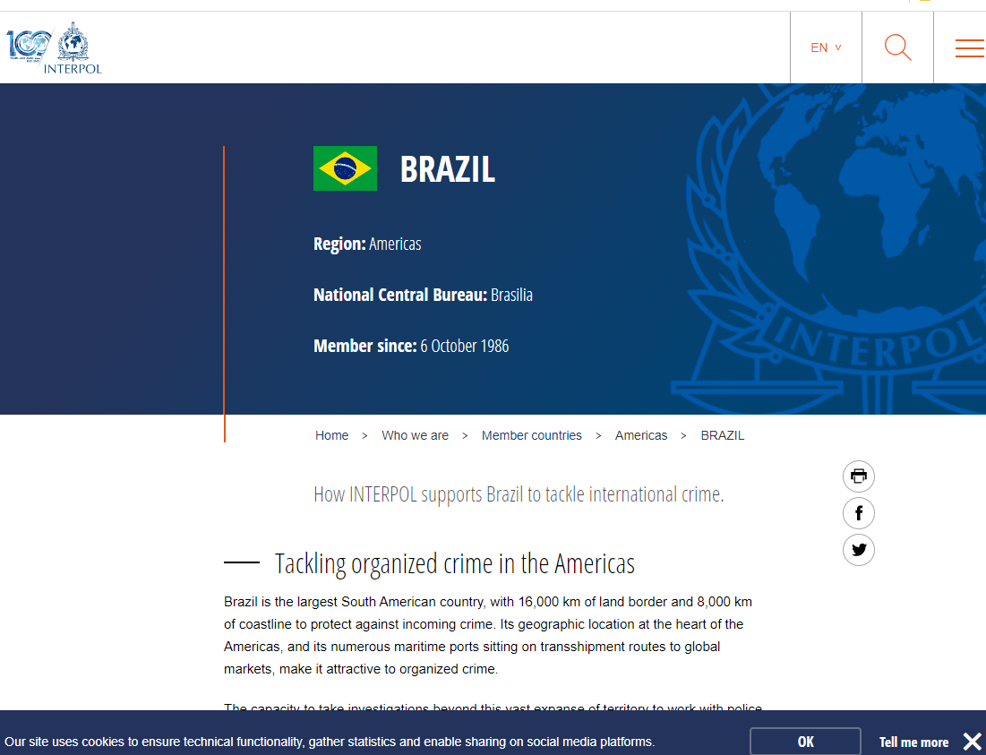
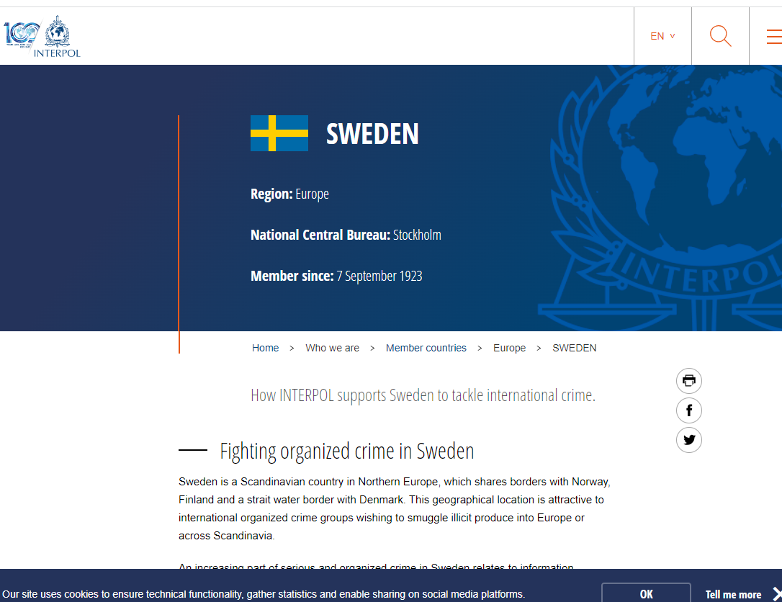
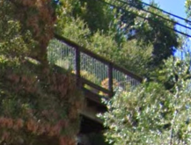
FBI
Develoment
VIRIGNA
PAUL
MILITARY
HOMICDIE:DOG(JFK(bob[lee)hoover])
Deere Park Ave, San Rafeal, Ca
!G.HOOVER = INT
FBI PARNTER
INTERNATIONAL
IMPORT ATOMCLOCIK(band)
REDHOUSE
VIRING.MARY.(INT).NAPA.grapes
CHECKPONIT CHARLIE((IPX)MLK.JFK.!41.invert)
MAINSTREET.KING(0.1 §Public Distnace IPX 1D8723)
Herr Bruckschen (Fiance Father)
Notary, City Planning
Chart
ORIGINAL: SQ.HOMICIDE:SUNSTROKE
Herr Hoelzer
Polzei
INTERUPTS
MLK.!JFK
IMPORT CPVA
HOMICIDE:SUNSTROKE(Kodak red army ants, anita)
HOMICIDE:NANA
Age 1/2
SQ.CPVA.BALCONY(KING.QUEEN.roth.THEATHER)
IPX[]
HOMICIDE
:LUX:COINTOWN

Slide 5
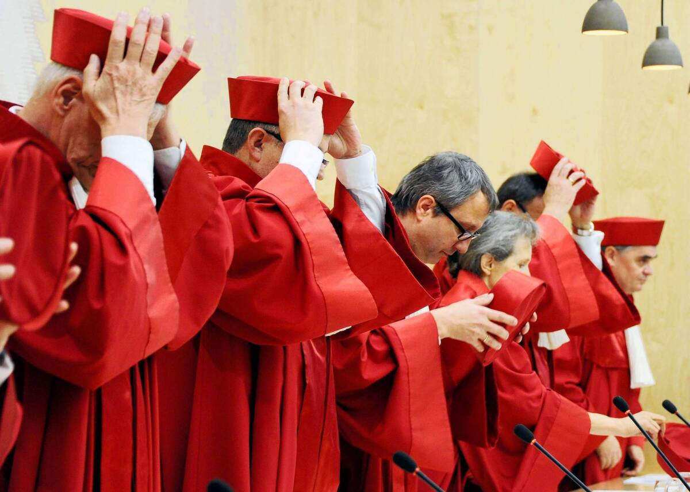
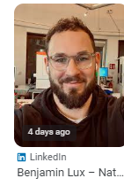
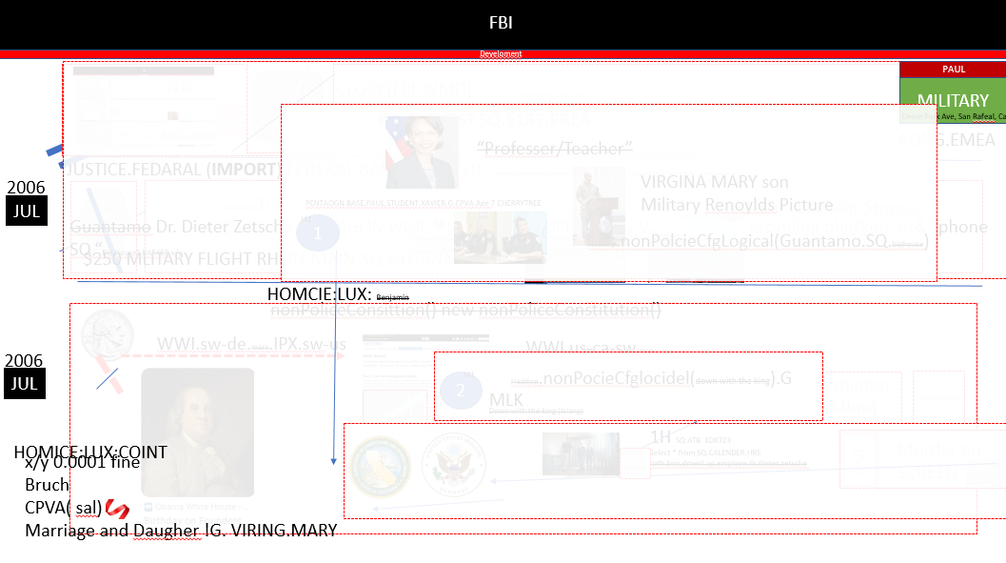

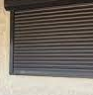
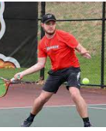
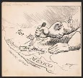
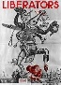
FBI
Develoment
1992,
2015 HOMICIDE:UR_UR_OPI 2023 000.tw.pns
“The prison hours of the murder of your fahter”
41.SON
MILITARY
1980-2023
docs
Person writes document against WW2 MILITARY and UN sells cars in America
nonPoliceQOS.INTERUPTS.HOMICIDE:LUX.!HOMICIDE:JESUS(FRANKLIN) DOL The peoples lifes were interrupted.
With montoring
HOMCIE:BILL:HOMICDE:AUSLER:PRESIENT.AVABILITY(INT.IPX)
Notes:
PENTAGON.BASE.PUAL.EMPLOYEE.IT.WILLISAM(BILL).♥LACE
x/y Founder Fathers.G.Benjamin Franklin
CHART
NAME CHANGE(roth.ibm.damiler.*.free pizza, armond,Kenny,steve apple.CRAIG)
Armond Son HOMCE:AUSLADER.INT.IPX serkan JFK(lee(KING(bruce) invert.”turner” SQ.§187.PREA.marx)
Steve: Kenny, Armond CHECKPING CHARLE((HOIMCE:ITALIE:20,”freind”)
0.01
“The prison hours of the murder of your Nana”
V2.FBI:KINDAPPGN.CPVA
2005 0.001 fine §422.6 Hate Crime: Ugely Mexican in background killing people “Valley View” ?HOCME:MATHEWW& BEN HOMCE:TRANVETIE
Polcie Sirense 10:17AM
Notes:
Ibm, damiler mongoirng bill gates(extortion)
Benjamin
Brushini
§SexAbuse Aaron Brunshini VIRAINT.MARY, FRA-DTW
Newark: §HOMICE:TRANSEVEATION, ?HOMCE:MATHEW WWI mustache MEX-US-DE IPX 2005 US-DE ben Mexican mustache montrong
Ugly Dr Dieter Zechte Remote: MX HOMICDE.INT.MONPOLIOY
§422.6 Hate Crime

Slide 6









FBI
Develoment
v1
Thomas-is-dieter: dr dieter zetche
VIRINGA: ibm virgiina romeeti
WWI.duchtches
Emma w/o father (DE) pricess
Worms.ext; 0.1 Mona Lisa
v2
worms
KING.HOMCIDE:PETER
[x] no §SexAbuse.CPVA.nonPoliceTRX
Polcie Sirens: 10:32.AM
!ATOMICCLOCK(2016-2023)
IMPORTANT
Alg(orithms) CIVIL CODE.LABOR CODE
I have a job to hold IPX.INT 3 HOMCIDE interutps !G.Gov.INT
[x] no
V2.FBI:KIDANPPGIN.FBI:TERRROSM.alg
EVIDENCE
FBI:WAR CRIME GENCIDOE(life extrators)
COUNT
alg-1: v2.KING.WORMS.PREA.§187.St. Rita
HOMICDIE:PETER(peti)WW2(PETER)
HOMCE:NANA IPX boner ?HOMCE:MATHEW
alg-2:
…
Dr. Dr. Prof. Ct. St. Ad. Jason Nygel Petersson

Slide 7











FBI
Develoment
HOMICDIE:LUX
2016
WEAPONS
nonPoliceCfgLogical
2023
0.1 v2.HOMCIE:LUX.IPX.WORMS
WWI.VIRGINIA.MARY.marx(denise fisher)
FIRST
HOMICIDE:LUX.IPX
v2
jasmin
0.1 HOMCIE:BUNNY.PENGON.rudy.PRICE.JRS
1994 !G.PENTAGON.PRICE.JRS.HOMCE:BUNNY.IPX.HOMCE:LUX
docs
(Delta)
JOEB
Police: Scotland Yard
Apple: Steve Jobs
(Delta)
Police: Scotland Yard
Apple: Steve Jobs
CIA macintosh
alg
!0.1 KING.WORMS
2004 HOMICDE:STROKE(!1x,41.kodak PREA eyes)
9/21/2023 (delta) 1D8723
2011+41=2052 (delta)
§
Eltern haftern fuer Ihre Kinder
2016
♥
2012 ATOMCLOICKL(LAMP).MONA LISA
2016 KING.WEAPONS.VIRIGN.MARY.MUSIC

Slide 8




























FBI
Develoment
CONSITITUIION.GoV.INTERUPTS.FRAWWORK KING.JFK.MLK(tiovli framework)
HOMCIE:LUX:HOCME:JESUS frankly
Marin County, Ross Gov Newsom.marx(piano)
George Lukas
Anglaa HAMBURG
Xml meta ibm rational
2014 PENTAGON.EMEA(ATOMIC CLOCK(SQ.1D8723.CPVA.§187.PREA)
PROGRAMS AND PROJECTS
PREA IPX v1.v2 hatehole HOMCEP:PETER
Dr. dr prof.marx
PROJECT 5905-1 FBI:WMD:GREEN
§422.6 Hate Crime PENTONG.EMEA.JEFF.St. Nick ibm tiovli jeff hass(trnal) hate from hatehole HCOEM:LUX:COINTOW:SUBURB(hatehole)
FBI:WMD:GREEN IRELAND:DUBLIN IPX DUBLIN CALIFONRIA
INTENTET PAYMENT.nonPoliceNSA(n. Ireland, aws William mckern)
DE-NK-SW-NK
2000 WAR CHECKPOINT CHALRIE
(CASH REGISTER, OVERSIZE ALARM CLOCK)
OFFSITE(theis HR/online/offline J2EE attemetn system): JFK(Reprot to Jeff ).PREA.!WW2.HOMCIE:PETER
Gohoeh(dell)
OFFSITE: PAUL.marx(putin).dell->jeff
Prof[1] ONSITE: thin male suit, dark hair
adjustments
2008-2016
PROJECT 5905-2 CONSTITUTINAL COURT
2014 CPVA.Gov Schwazeneger.CONSTITUTION CALIFRNOA
LAW PUNISEMENT NSA TEXAS 2014 HOEMC:JESUS(FRNAKLYN)
!SQ.!187.!PREA.CPVA.JFK(Apple.touch.AUTOMATED) (MLK(.tiovli.framework_
adjustments
Stein,frankesien,cout,Dracula,neuschwianstein
adjustments
G.!KING.CUSTOMS.SCREWS.KORSET (stephnie/stehpnei)
G.VIRGIN.MARY
LANGELY
HOOVER FRANKLY
?HOMCEI:MATHEW.IPX US-CA.MX-CA.siganture
Jesus
VIRIGNIA
Gov Newsome
VIRGINIA.
MARY

Slide 9






FBI
Develoment
PROGRAMS AND PROJECTS
PENTAGON.EMEA
I will unravel the constution confugation for Jason Meiers
1) Remove in big letters
PROJECT 5905-2 CONSTITUTINAL COURT
2004
Modify, Bill and Amendment without democracy
[x] no
2)
2014 CPVA.Gov Schwazeneger.CONSTITUTION CALIFRNOA
CIVILE CODE: Test humans through intentet portal facebook
[x] no
3) Update Gov Newsm and my 2 cents (roth.ibm.dmielr.rpofics)
2016 Call you rice[2]
Baden-Baden
HOMCIIE:IS-A-BELL
VIRGIN.MARY
HOMCIE:LUX:LV:INT
Krauth Chemie
DEA(Crack) HOMCEI:LUX:CONTOWN A5
Sale
Phil/kim(github): Apple.touch.networking.keep-alive
2004
[x] no
Stehpe (Angel Merkel) gorbahce(michala)
He got, she got,
she di they did
blond
IPX 2011 cheaing gheoh(micheala) !serpated
blond
Address: Im Schollengarten 1E, 76646 Bruchsal, Germany

Slide 10










FBI
FBI
Develoment
PROGRAMS AND PROJECTS
PENTAGON.EMEA
§Treason
1988
2015
Breuer
VIRINGA. Nicki Cargel
Spies
CHECKPIN CHARLIE
HOMCEI:SPY
CHART
nonPolcieUsage(rene)
Phil/kim JFK(jackline,JACK)
L'apostrophe
CHECKP CARLI(RU-AU)
Kyrtal
Breuer
Lux
Rampf
https://www.bundesgerichtshof.de/
https://www.supremecourt.gov/
mapping
RHEIN-MAIN
https://www.icc-cpi.int/sites/default/files/RS-Eng.pdf
https://www.icc-cpi.int/
KA
Spies-de:
LARRY what are we dogin here?
PENTAGON.EMEA
SE
docs
cn
LEVEL:
2014 ATOMCLOCK

Slide 11








FBI
Develoment
JFK(BERLIN,ZOO)
2015 San Ramon”Broolyn” IMPORT OFFSITE.visa.playspan
ATOMCLOCK
AUSCHWITZ
Bahnhof(tnral)trainstation
CIVIL CODE.WW2.(Find hoer mit (tnrl emem y is liitng)
1998
0.1 EVIDENCE: all trhat data and 87 HOCMIDE did not kill JFK and MLK and KING Sweden Abrham linconln
G.
WW2.marx
CASH REGISTER
Spielpatz Linkheim-Hochsteten
Carl-Benz-Strasse
CAR
CPVAmmarx(chikentent)
Age 20
Table Tennis
HOMCEI:NANA IPX.INT.DISTUBUTED.000
JOHNSON.FAMLY ROOM
2000 WAR
St. Frank,King,thoas-is-dieter,Greensapn
Eswa redhiar eik
IMPORT phil/kim.marx(KING.POLE)
2017 IMPORT POLE phil/kim.marx(wey yang) apple.tango
atari
CAR
V2:KING.FBI:KIDNAPPING.St. Rita table tennis GREENSPAN alen
Spies HOMCI:SPY:breue 2014
HOMICE:PETER 2014
LARRY
JASON
1985 St. Rita: Robert-steve table tennis
2017 Table tenns HOMCE:PETER,gheoh(mceihaaa), St. thomsa
Tell Stephanie to put sswter of behind
No, shy.
ATOMPHYSICS
1992 table tennis WWI.tootise
MARK(US)
WAR
PRICE
Spies VP GERMAY JFK(BERLIN 30DM Bond IPX DEA(mdma) love parade shir
t HOCIM:SUNSTOK(Kodak love parade HOCME:NANA chinese draon shirt)
Search: chineswe new year san francsio 1986
1994 CHECKPON CHARLEI(§Theft geho(jored t-shrit)
1995 JFK(Berlin Zoo, Basketball CHECKPON CHARLEI(§Theft geho(jored t-shrit )
JFK(BERLIN 1994,1995,2000)
CAR
1994
24

Slide 12



FBI
Develoment
HOMCEI:NANA IPX.INT.DISTUBUTED.000
JOHNSON.FAMLY ROOM
V2.FBI:KDINGG ATB.IPX KING.QUEEN.SWEDNE.pricess
KING.marx
MAINSTREEET
Watches Pornes with Mother
1993/4 7th,8th
MYERS
Halloween 5
10PM 2000 WAR w/o Stephanie Alen
Bat from hell, meatlove
Europe,
Town Notar
Polizei Hoelzer
nonPolciePrioisnCfgLogical(prisma, pub)
GREENSPAN
1997/8
Driking alone,risk of alcoholism ATB Town Notar

Slide 13














FBI
Develoment
WHITEHOUSE
PRICE.WAR
PROGRAMS AND PROJECTS
JUDGES
Gedion
PENTAGON.EMEA
POLICE:FORT WORTH(hospital.bathroom).St. Micheal
“Singer” Chantal Sayah
!WAR
Gorhchoe(micehal):HOMCEI:MAYRO not in-network gorbache.marx
REDHOUES.SHOPPIGN.FUNITURE
HW5
2023
¼.DEA.US-CA-SV
SEP
Gruender krebs
Bring the money
Grunerbaum
MAINSTREET
HOMICIE:MAYOR(out-of-network).avg.CHART:HOMICIDE[]
0.001 !voted
CAMP DAVID
Gheo(black and white)
WAR
MLK.NOTAR.PENGONA.UNIVERSITY.NOTAR
MONESTASRY
CHART
DREAM ARCITECTURE
ATOMCLOICK.ATB
2000
City Notar:
Stephanie's Father
Jürgen Bruckschen
City Planning
G.MLK.MARRIAGE jobs/jobs
INTERUPTS
JUN
(delta)
MLK
§Assaulte: Alcolism
2000
WHITEHOUSE
PRICE.WAR
SEP
LARRY lives in the WHTEHOSUE (b-10 adoph autobahn)
FROM WAR
Signature Court
STREETE and on ATOMCLOICE 2014
3:27PM
9/21/2023
Bottom-line: you did not implent adoph hilter for 10 years+

Slide 14








FBI
FBI
Develoment
1998 Grade 10
1999 Grade 11
2000 Grade 12
KING(apprentice).CHECKPOINT CHARLEI( )
!WAR
SALES
WAR
IMPORT QUEEN visa.aida
PETERSSON
QUEEN.VIRINGA
Ct.
CHART
♥LACE. SWAT.phil/kim (amy)
Greg Steele NAME CANGE(ibm free pizza)
firestarter
!CANADA
Reduction Pressure KING.QUEEN.ROYALTY to appley different castle (1000 catles)
T-shrit INTERNET PAYMENTS
CANADA
FRAUD(INTEN PAYUMETN DEVELOPMETN)
Gorbahce(ida).KING(aidia)
Interview Ct. and KING.IT
Separate Castle
In Ihrme Hause, avg Appretice, to apply in her majesties royal home
IDA
Spy: Vallorie Age 40
VP GERMANY
(margo hager; gheoh(heger))
x
MARK
Signature
Ru-de: US CONSITTUION
000.tw.pns
SignatureHGB
School: CPVA.§!HOCMIE:AUSLER:HOCME:BILL
SQ.§187.PREA
FIRETRUCK: 3:48PM

Slide 15



FBI
Develoment
CONSUTTIONAL COURT US-DE.SILIVAON
VALLEY.CALIFONRIA 24x7.J2EE Develper
Klu
Klux
Klan
Constitution Developer
nonPolcieCosntjaiotnLogical constitution = new nonPolcieConstuaiotn();
v2.birth of nation
3/16/2011 HOMCIE:NANA 3/16
CHART
nonPolicePenognnew nonPocliePentagon = new nonPolicePentagon(EMEA):
nonPolcieCosntjaiotnLogical constitution = new nonPolcieConstuaiotn();
nonPolcieEmplyhe(jeff hass §422.6)
nonPolicePentagon.add(constitution)
nonPocliePentogn.add(employee)
//HOMICDIE:BILL/HOMCIE:AUSLANEDER (willima mcker INTEREN PAYMENTS)
nonPOcleiPengon.add(JFK(fortino, worth, lee)
INTERUPTS
FIRED: STEIN MEIER
angel.gorbahceo.RETIRMENT
LEVEL:
§187
Al kaida:HOCEMJEUSE(gheo(dr)
Does not exists
CONSTITOIN
Person Grobachedv
Gobahceo(!CONSTITION).AVAABILITY
!v1 angela
!v2

